Slide 1

NETFLIX DATA ANALYSIS USING MY SQL
Name: Archana Shinde
Subject: DBMS Project
Database: Netflix_db
Table: Netflix_titles

Slide 2

Objective & Tools Used
Objective: To analyze Netflix movies and TV shows data to find content trends, country-wise distribution and ratings.
Tools Used:
1. MySQL Workbench - For Database & Queries
2. Netflix_titles.csv Dataset (8807 Records)
3. PowerPoint - For Presentation

Slide 3
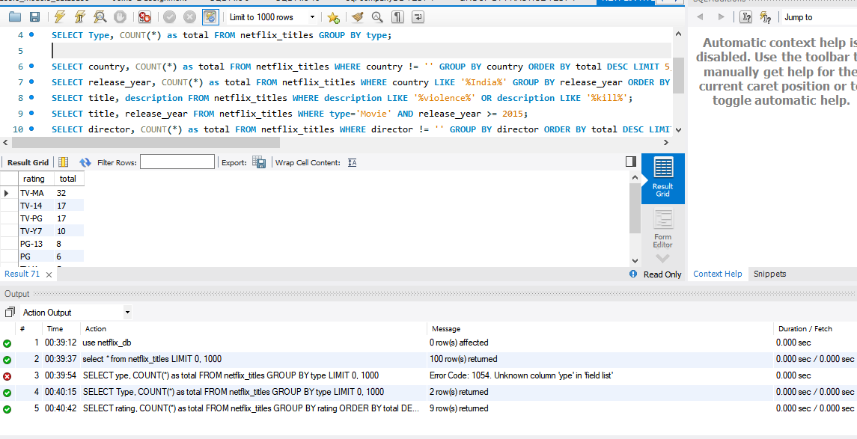
Data Import & SQL Queries RESULTS

Slide 4
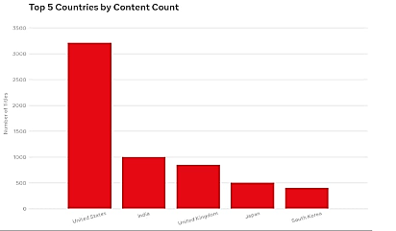
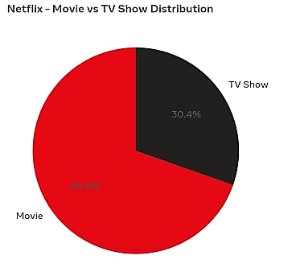
Data Visualization - Charts

Slide 5

CONCLUSION
Netflix Data Analysis - Key Findings
  1. Content Dominance: The United States has the highest number of titles on Netflix with 2,818 contents, followed by India with 972 titles.
  2. Type Distribution: Movies dominate the platform with 70% content, while TV Shows account for 30%.
  3. Ratings Insight: TV-MA is the most common rating, showing that mature content is more popular.
  4. Growth Trend: The year 2019 recorded the highest number of new releases on Netflix.
  5. Learning Outcome: With MySQL, we can easily analyze large datasets to find business insights.

Slide 6

Presented by
ARCHANA SHINDE

